Slide 1
Model View Matrix and its implementation
Sang Il Park
Department of Software

Slide 2
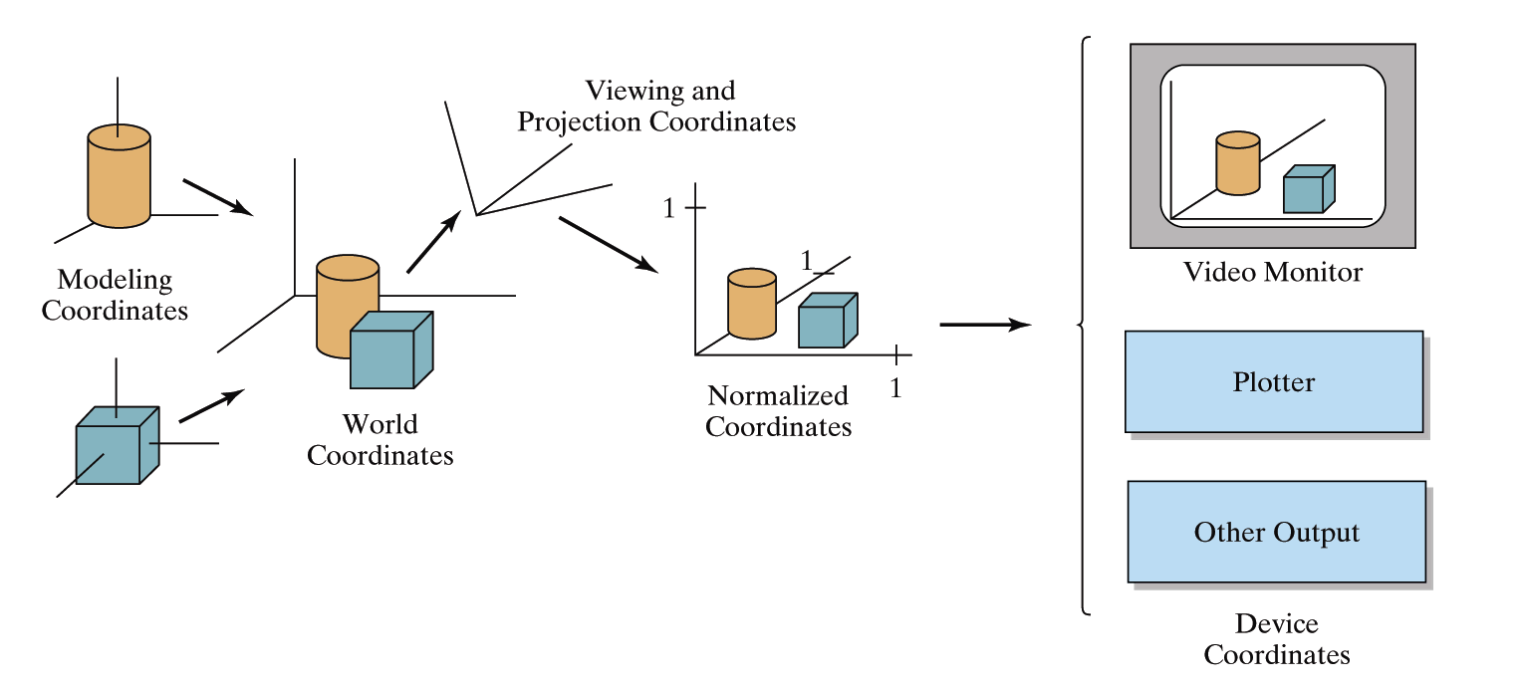
OpenGL Geometric Transformations
Consecutive Transformations
in OpenGL Pipeline
Model Transform
: local to world
View Transform
: world to camera
Projection Transform
: camera to screen

Slide 3
OLD OpenGL Matrices
Two types of predefined transformations
(matrices)
  Model-View (GL_MODELVIEW) : model+view
  Projection (GL_PROJECTION)
Single set of functions for manipulation
Select which to manipulated by
  glMatrixMode(GL_MODELVIEW);
  glMatrixMode(GL_PROJECTION);
E. Angel and D. Shreiner: Interactive Computer Graphics 6E © Addison-Wesley 2012

Slide 4
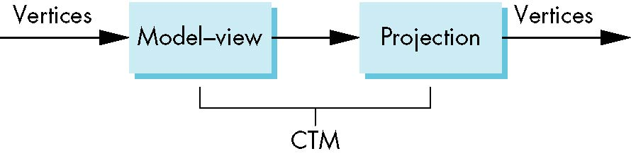
Current Transform Matrix (CTM) in OLD OpenGL
OpenGL had a model-view and a projection matrix in the pipeline which were concatenated together to form the CTM
We will emulate this process
CTM: Current Transform Matrix

Slide 5
OLD OpenGL
Geometric Transformation functions
Basic Transpormation:
  glLoadIdentity();
  glTranslatef(tx, ty, tz);
  glRotatef(theta, vx, vy, vz); angle-axis
    (vx, vy, vz) is automatically normalized
  glScalef(sx, sy, sz);
  glLoadMatrixf(Glfloat elems[16]);
Multiplication
  glMultMatrixf(Glfloat elems[16]);
  The current matrix is postmultiplied by the matrix
  Column major

Slide 6

연습: 바람개비(풍차)만들기

Slide 7
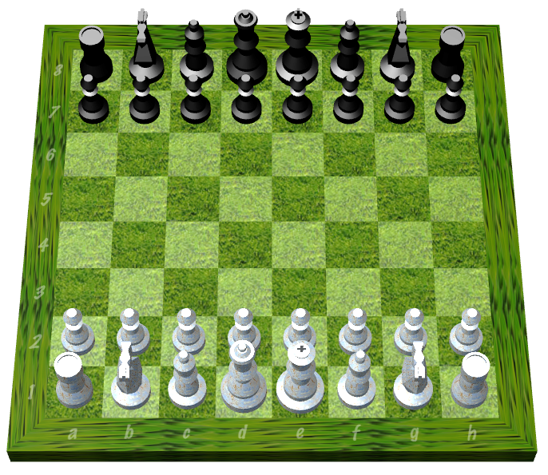
Instance Transformation
Often we need several instances of an object
  Wheels of a car
  Arms or legs of a figure
  Chess pieces

Slide 8
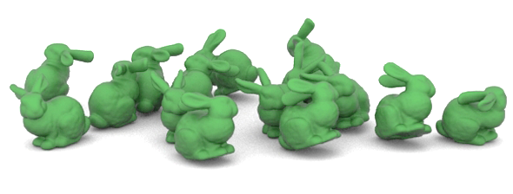
Instance Transformation
Instances can be shared across space or time
Write a function that renders the object in “standard” configuration
Apply transformations to different instances
Typical order: scaling → rotation → translation

Slide 9
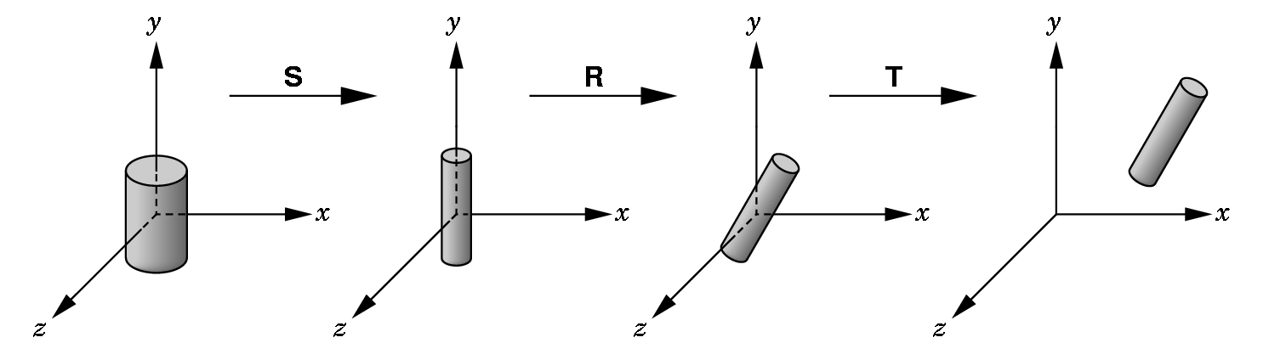
Instance Transformation
Instances can be shared across space or time
Write a function that renders the object in “standard” configuration
Apply transformations to different instances
Typical order: scaling → rotation → translation

Slide 10
구체적인 계획
0.8
y
y
0.25
x
1
z
0.5
0.4

Slide 11
로보트 팔 만들기

Slide 12
로보트 팔 만들기2

Slide 13
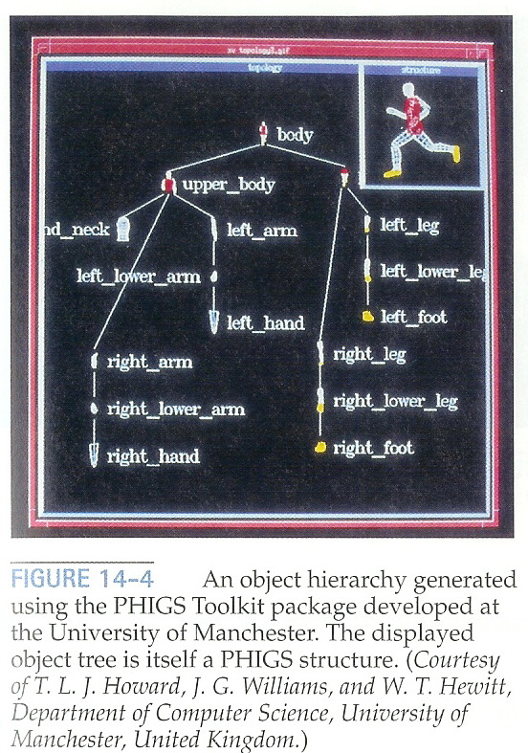
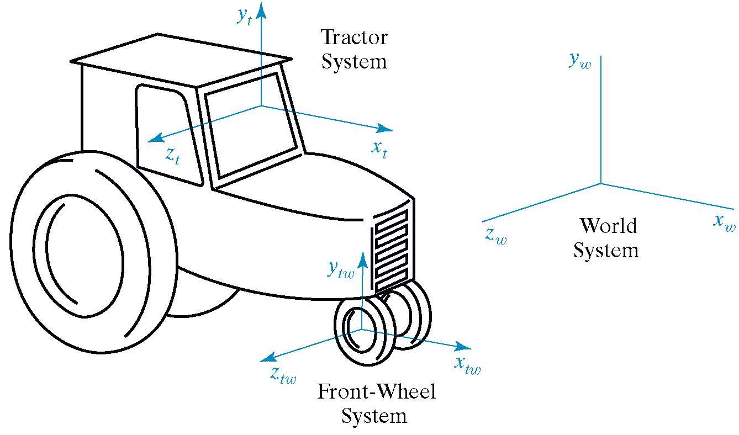
Hierarchical Modeling
A hierarchical model is created by nesting the descriptions of subparts into one another to form a tree organization

Slide 14
OpenGL Matrix Stacks
(OLD)
Stack processing
  The top of the stack is the “current” matrix
  glPushMatrix(); // Duplicate the current matrix at the top
  glPopMatrix(); // Remove the matrix at the top

Slide 15
Matrix Stacks by your own
We emulate Matrix Stacks by using:
  Linked List such as std::list or std::deque
  Or a tree structure for more generality.

Slide 16
Model View Matrix II:
Camera Positioning

Slide 17
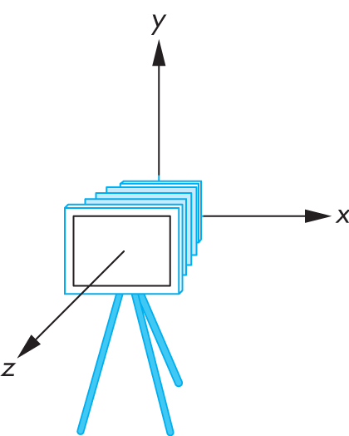
Transform Camera = Transform Scene
Camera position is identified with a frame
Either move and rotate the objects
Or move and rotate the camera
Initially, camera at origin, pointing in negative z-direction

Slide 18
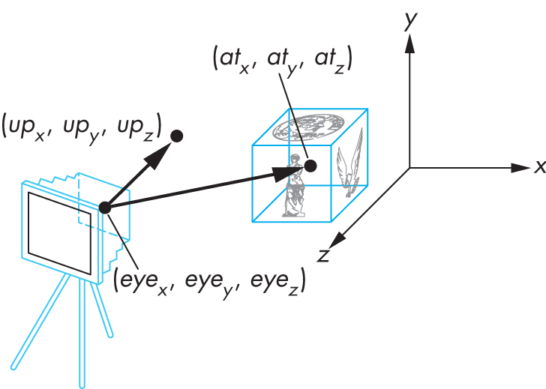
The Look-At Function
Convenient way to position camera with three parameters:

Slide 19
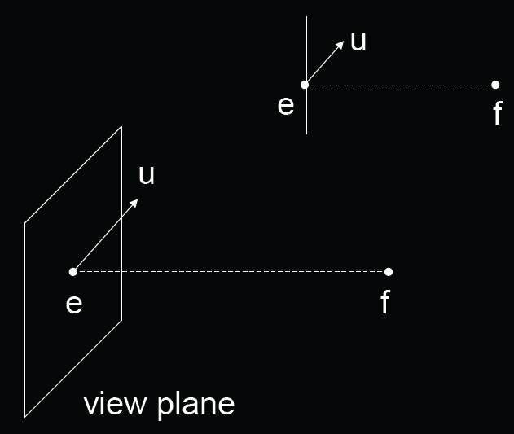
The Look-At Function
(OLD Style)
gluLookAt (ex,ey,ez, fx,fy,fz, ux,uy,uz);
e = eye point (eye)
f = focus point (at)
u = up vector (up)

Slide 20
Old OpenGL code
void display()
{
glClear (GL_COLOR_BUFFER_BIT |
GL_DEPTH_BUFFER_BIT);
glMatrixMode (GL_MODELVIEW);
glLoadIdentity ();
gluLookAt (ex,ey,ez,fx,fy,fz,ux,uy,uz);
...
renderObjects();
glutSwapBuffers();
}

Slide 21


How to Compute?
Cx
Cz
eye
at
Wx
Wz

Slide 22


2D case: Translate + Rotation
Cx
Cz
eye
Cx
at
Cz
R_{c}
T_{c}=translate(-eye)
eye
Wx
at
Wz

Slide 23

2D case: Translate + Rotation
Cx
Cz
eye
at
at
V=R_{c}T_{c}
R_{c}
T_{c}
eye
Cx
Wx
Cz
Wz
R_{c} is not easy to compute!

Slide 24
Instead,
Think about inverse transform:
Cx
Cz
eye
R_{c}=(R_{w})⁻¹
Wx
at
Wz
=(R_{w})^{T}
R_{w}
Wx
Wz

Slide 25
Implementing the Look-At Function
Plan:
Transform world frame to camera frame
  Compose a rotation R with translation T
  W = T R
Invert W to obtain viewing transformation V
  V = W⁻¹ = (T R)⁻¹ = R⁻¹ T⁻¹
  Derive R, then T, then R⁻¹ T⁻¹

Slide 26
Viewing in OpenGL
Remember:
camera is pointing in the negative z direction

Slide 27

World Frame to Camera Frame I
Camera points in negative z direction
n = (f – e) / |f – e| is unit normal to view plane
Therefore, R_{w} maps [0 0 -1]^{T} to [nx ny nz]^{T}
Cy
u
n
Cz
e
f
Cx
Camera plane

Slide 28

World Frame to Camera Frame II
R_{w} maps [0,1,0]^{T} to projection of u onto view plane
This projection v equals:
  α = (u · n) / |n| = u · n
  v₀ = u – α n
  v = v₀ / |v₀|
Cy
u
v₀
α
n
Cz
e
f
Cx
Camera plane

Slide 29

World Frame to Camera Frame III
Set w to be orthogonal to n and v
w = n x v
(w, v, -n) is right-handed
Cy
v
n
Cz
e
f
Cx
w
Camera plane

Slide 30

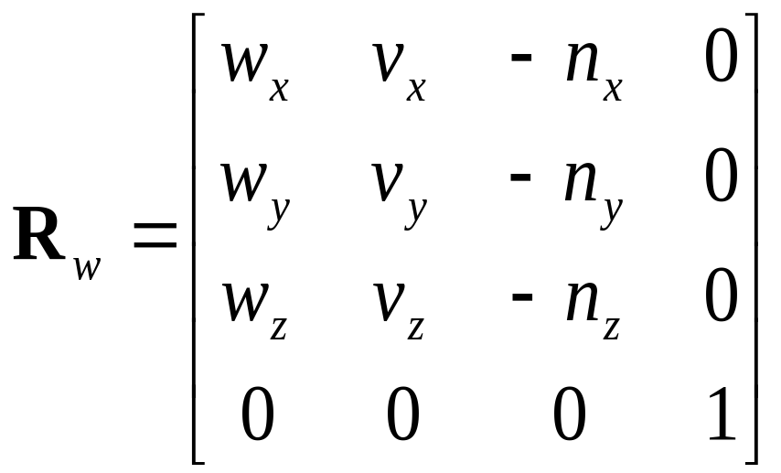
Summary of Rotation
gluLookAt (ex,ey,ez, fx,fy,fz, ux,uy,uz);
n = (f – e) / |f – e|
v = (u – (u · n) n) / |u – (u · n) n|
w = n x v
Rotation must map:
  (1,0,0) to w
  (0,1,0) to v
  (0,0,-1) to n
Cy
v
n
Cz
e
f
Cx
w
Camera plane

Slide 31
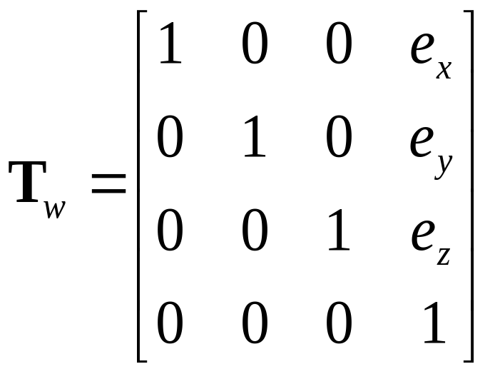
World Frame to Camera Frame IV
Translation of origin to e = [e_{x} e_{y} e_{z} 1]^{T}

Slide 32
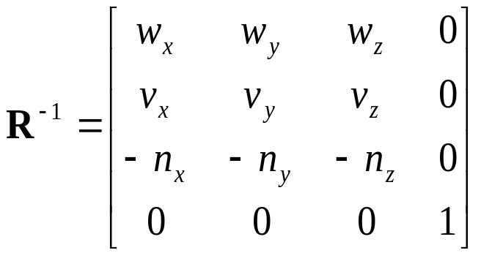
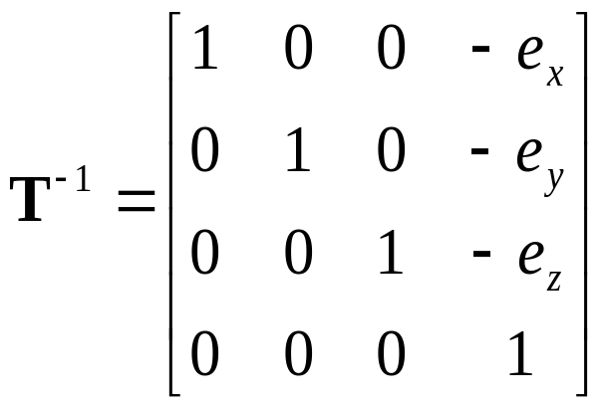
Camera Frame to Rendering Frame
V = W⁻¹ = (T_{w} R_{w})⁻¹ = R_{w}⁻¹ T_{w}⁻¹
R is rotation, so R_{w}⁻¹ = R_{w}^{T}
T is translation, so T⁻¹ negates displacement

Slide 33
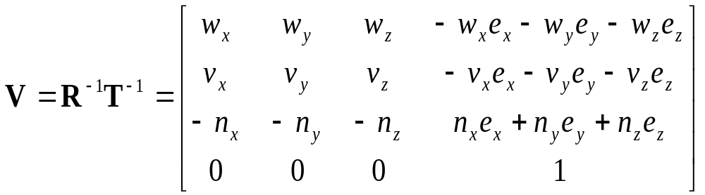
Putting All Together
Calculate V = R_{w}⁻¹ T_{w}⁻¹
This is different from book [Angel, Ch. 4.3.2]
There, u, v, n are right-handed (here: u, v, -n)

